Slide 1
DeyGo
A Passenger Positioning System

Slide 2
Diagrams
01
02
03
04
Use Case
Class
Sequence
Activity

Slide 3
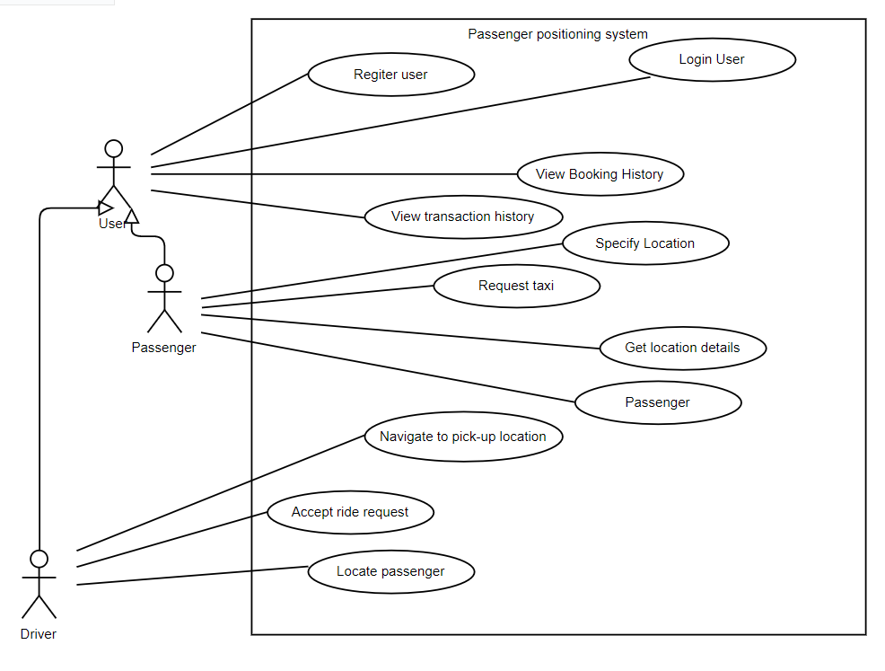
Use Case Diagram
The main actors in this system is the Driver and the Passenger who are all Users.
These actors perform a couple of activities such from booking trips to getting passenger information and more

Slide 4
Actors and their interactions with the system!
We have two main actors: drivers and passengers that could perform
Actions such as:
Requesting for a ride
Locating passengers
Navigating to passenger location and so on.
Various users carry out different activities on the system

Slide 5
Two Main Actors
Passenger
Drivers
The main aim of the passenger is to book a ride, get a ride and enjoy the ride
The main aim of the driver is to reduce fuel consumption and find optimal routes

Slide 6
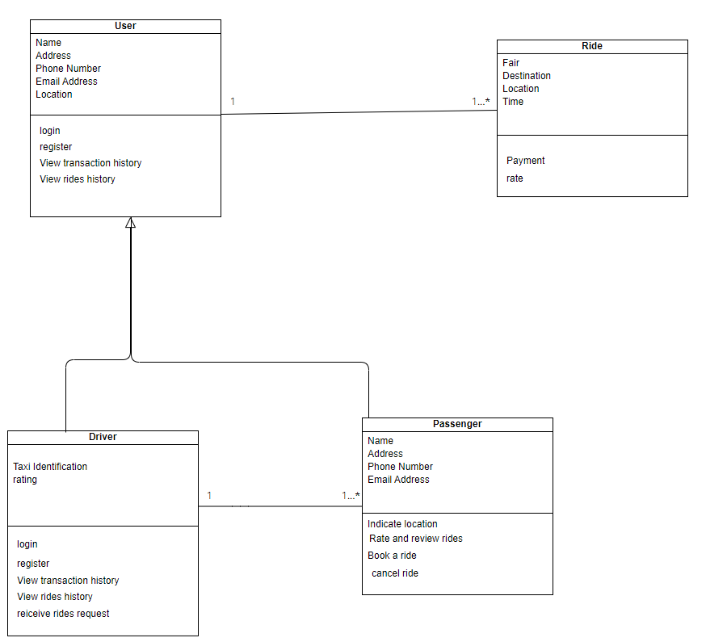
Class Diagram
The main classes in the system are the Driver, Passenger and Ride.
There is also a User class which generalizes aspects of the driver and passenger classes

Slide 7
Sequence Diagrams

Slide 8
Sequences
Make Payments
Request Taxi
Register/Log In
Get Location Details
View Locations
Locate Passengers

Slide 9
Sequences
Navigate to Pick up Location
Accept Ride Requests
View Transaction Details
Make Payments
View Driver Location

Slide 10
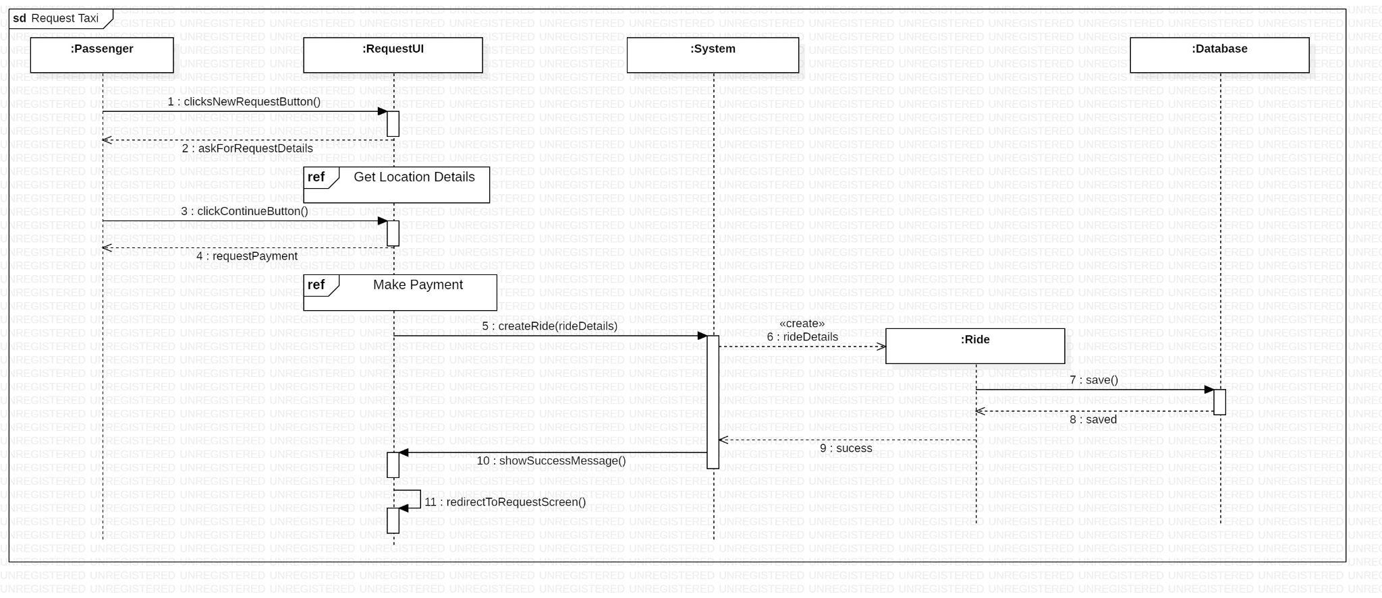
Request Taxi
Making a payment for a taxi to come to your location

Slide 11
Activity Diagrams

Slide 12
Activities
Locate Passengers
Request Taxi
Register
Specify Location
Navigate to Pick Up Location
Log In

Slide 13
Activities
Accept Ride Requests
Make Payments

Slide 14
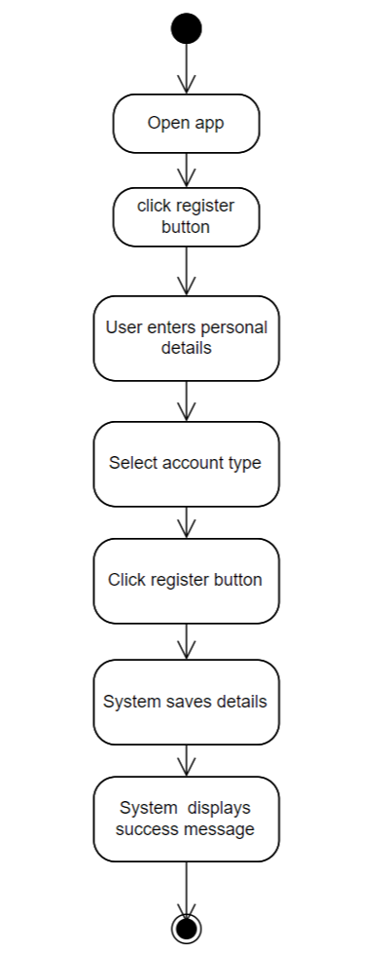
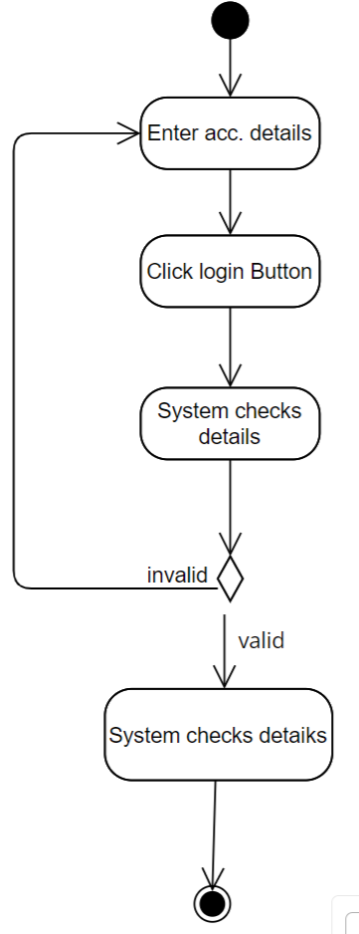
Register
Login
Authentication
Through these processes, the user can be authenticated into the system.

Slide 15
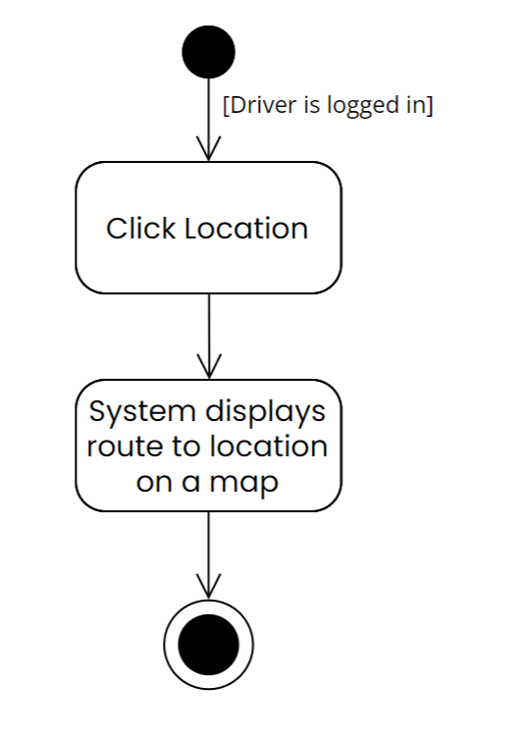
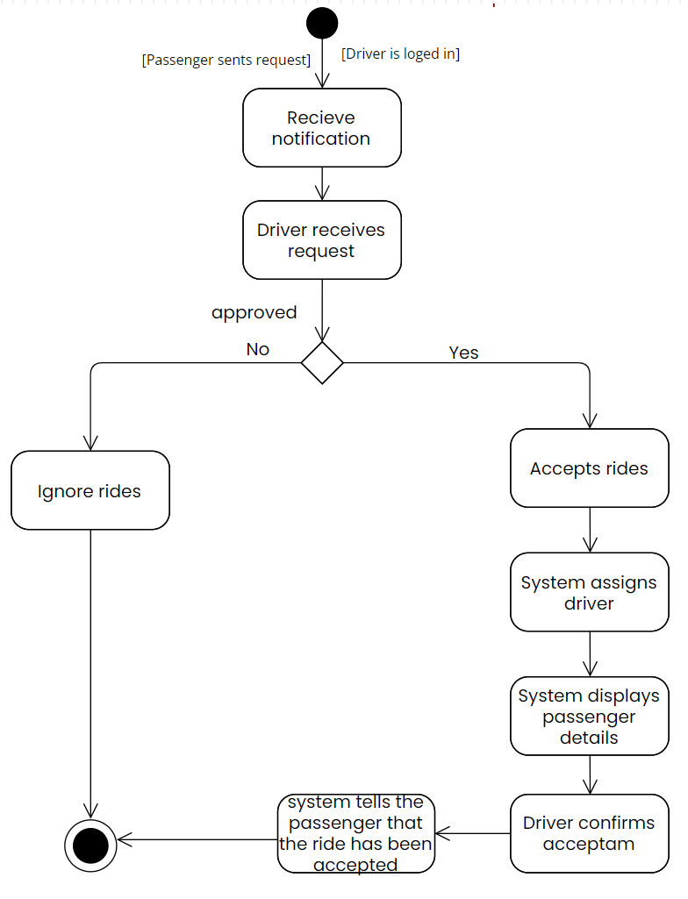
Accept ride
Locate passengers
Accept rides
Locate passengers
Through these processes, the user can be authenticated into the system.

